Slide 1
Tackling the smoking epidemic
IPCRG Smoking cessation guidance for primary care
Notes:
Title page option 1

Slide 2
The smoking epidemic
Stage I
Sub-Saharan Africa
Stage II
China, Japan,
SE Asia,
Latin America,
N Africa
Stage III
Eastern and Southern Europe
Stage IV
W Europe,
N America
Australia
Adapted from Lopez AD, et al.. Tobacco Control 1994; 3: 242-247

Slide 3
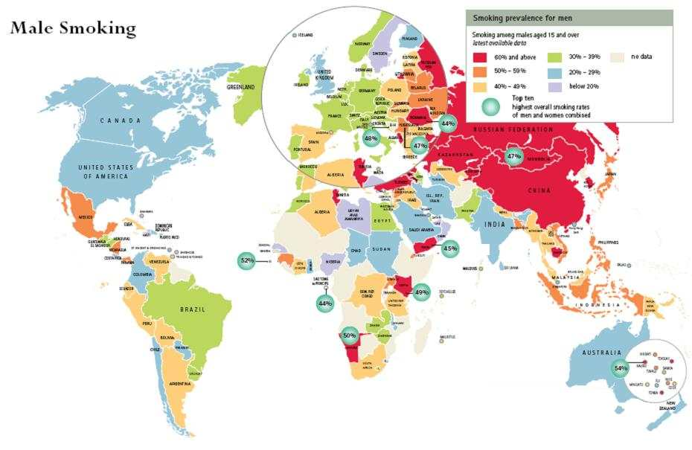
The smoking epidemic
75% of smokers live in low or middle income countries
Male smoking
World Health Organization. The Tobacco Atlas. http://www.who.int/tobacco/statistics/tobacco_atlas/en

Slide 4
The smoking epidemic
1 billion smokers
5 million people die every year
This figure will have doubled by 2030
75% of smokers want to quit
<2% of smokers quit each year
Primary care can help increase quit rate
World Health Organization. The Tobacco Atlas. http://www.who.int/tobacco/statistics/tobacco_atlas/en

Slide 5
The smoking epidemic
Effective government policy:
Bans on tobacco advertising and sponsorship
Regular price rises
Stronger public health warning labels
Smoking bans in all public places
“Support for smoke free policies increases among smokers and non-smokers alike once the policies are introduced”
Jamrozik K. Population strategies to prevent smoking. BMJ 2004; 328: 759-762

Slide 6
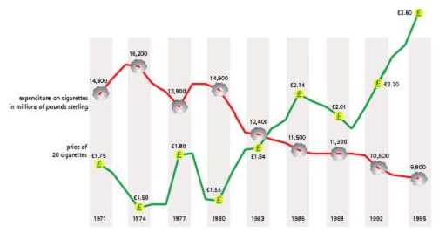
The smoking epidemic
Effective government policy:
Smoking goes down as prices go up
World Health Organization. The Tobacco Atlas. http://www.who.int/tobacco/statistics/tobacco_atlas/en

Slide 7
The smoking epidemic
Effective government policy:
Stronger public health warnings
Department of Health. Picture warnings on tobacco packs. http://www.dh.gov.uk/publications

Slide 8
Quitlines
Quitline can:
Direct smokers to appropriate assistance
Provide ‘one-off’ cessation help
Provide systematic ‘call-back’ counselling
A useful adjunct to advice and support offered in primary care (number needed to treat = 4)
http://www.naquitline.org/pdfs/NAQC_Quitline_06_by_pg.pdf
www.quitnow.info.au
3Stead LF, et al. Telephone counselling for smoking cessation. Cochrane Database Systematic Reviews. 2006

Slide 9
The benefits of quitting
Within hours.......
8 hours
Nicotine and carbon monoxide levels halved,
Blood oxygen levels return to normal
24 hours
Carbon monoxide eliminated from the body
48 hours
Nicotine eliminated from the body,
Taste buds start to recover
Action on Smoking and Health (ASH) Factsheet Number 11: Stopping Smoking. http://www.ash.org.uk

Slide 10
The benefits of quitting
Within months .......
1 month
Appearance improves
– skin loses greyish pallor, less wrinkled
Regeneration of respiratory cilia starts
Withdrawal symptoms have stopped
3-9 months
Coughing and wheezing decline
Action on Smoking and Health (ASH) Factsheet Number 11: Stopping Smoking. http://www.ash.org.uk

Slide 11
The benefits of quitting
Within years .......
5 years
The excess risk of a heart attack reduces by half
10 years
The risk of lung cancer halved
Action on Smoking and Health (ASH) Factsheet Number 11: Stopping Smoking. http://www.ash.org.uk

Slide 12

A smoking aware practice
GP time
Increase in quit rate
5-7 fold
>5 mins
Intense intervention
4 fold
2-5 mins
Moderate intervention
<1 mins
3 fold
Brief intervention
2 fold
A ‘no-smoking practice’
Adapted from Litt J, et al. Asia Pacific Fam Med. 2003; 2: 175-9

Slide 13
A smoking aware practice
A ‘no-smoking practice’....
Display no smoking posters.
Ban smoking on practice premises
Routinely identify the smoking status of patients
Flag the records of smokers.
Promote self-help materials, leaflets,
Display quitline numbers in the waiting room.
2 fold
... can double the quit rate
Adapted from Litt J, et al. Asia Pacific Fam Med. 2003; 2: 175-9

Slide 14
A smoking aware practice
Brief intervention ....
Ask about smoking status at all opportunities
Involve all members of the practice team
Assess desire to quit,
Provide self-help materials
Refer to available smoking cessation services
... can treble the quit rate
3 fold
<1 mins
Adapted from Litt J, et al. Asia Pacific Fam Med. 2003; 2: 175-9

Slide 15
A smoking aware practice
Moderate intervention ....
Ask about smoking status at least annually
Assess desire to quit, dependence and barriers to quitting
Provide self-help materials
Advise on strategies to overcome barriers
Set a quit date
Assist by offering pharmacotherapy
Arrange follow-up (or refer to smoking cessation services)
... four times the quit rate
4 fold
2-5 mins
Adapted from Litt J, et al. Asia Pacific Fam Med. 2003; 2: 175-9

Slide 16
A smoking aware practice
Intense intervention ....
Ask about smoking status at all opportunities
Assess desire to quit, dependence and barriers to quitting,
Discuss high risk situations, explore confidence
Advise on strategies to overcome barriers.
Address dependence, habit, triggers, negative emotions.
Brainstorm solutions and develop a quit plan.
Assist by offering pharmacotherapy
Arrange follow-up consultation
5-7 fold
... five times the quit rate
>5 mins
Adapted from Litt J, et al. Asia Pacific Fam Med. 2003; 2: 175-9

Slide 17
The cycle of change
Relapse
Pre-
contemplation
Maintenance
Cycle of change
Do you smoke?
Action
Contemplation
Have you considered quitting?
Determination
Adapted from Prochaska JO, DiClemente CC. J Consult Clin Psychol 1983; 51: 390-5

Slide 18
The cycle of change
Not yet considered quitting
Pre-
contemplation
Explain importance of cessation
Offer help as and when they want it.
Be a positive partner
Focus on the positive health effects of cessation
Adapted from Prochaska JO, DiClemente CC. J Consult Clin Psychol 1983; 51: 390-5

Slide 19
The cycle of change
Ambivalent to cessation
Pre-
contemplation
Move them closer to a cessation attempt
Understand how you can help
Be a positive partner
Let them describe their doubts – and fear of failing
Identify how to plan a quit attempt
Offer the ongoing medical support
Contemplation
Adapted from Prochaska JO, DiClemente CC. J Consult Clin Psychol 1983; 51: 390-5

Slide 20
The cycle of change
Ready to make a cessation attempt
Pre-
contemplation
Provide support for a quit attempt
Be supportive and enthusiastic!
Give time to planning the attempt
Set a quit date
Discuss problems of withdrawal
Contemplation
Determination
Adapted from Prochaska JO, DiClemente CC. J Consult Clin Psychol 1983; 51: 390-5

Slide 21
The cycle of change
Action! a cessation attempt
Pre-
contemplation
Be available to support the quit attempt
Congratulate!
Arrange review
(even if relapse)
Action
Contemplation
Determination
Adapted from Prochaska JO, DiClemente CC. J Consult Clin Psychol 1983; 51: 390-5

Slide 22
The cycle of change
Maintain!
Pre-
contemplation
Maintenance
Maintain smoke-free
Be positive!
Support over time
Emphasise
health benefits
Action
Contemplation
Determination
Adapted from Prochaska JO, DiClemente CC. J Consult Clin Psychol 1983; 51: 390-5

Slide 23
The cycle of change
Relapse
Relapse is common
Pre-
contemplation
Support
Learn from the quit attempt
Maintenance
Move forward!
Relapse is common
They can quit
Not back to square one
Action
Contemplation
Determination
Adapted from Prochaska JO, DiClemente CC. J Consult Clin Psychol 1983; 51: 390-5

Slide 24
The cycle of change
Relapse
Pre-
contemplation
Maintenance
Cycle of change
Smokers may move backwards or forwards, to and fro across the cycle many times before finally quitting
Action
Contemplation
Determination
Adapted from Prochaska JO, DiClemente CC. J Consult Clin Psychol 1983; 51: 390-5

Slide 25
Motivational interviewing
Key principles
Regard the person’s behaviour as their personal choice
Let the patient decide how much of a problem they have
Avoid argumentation and confrontation
Encourage the patient to discuss the advantages and disadvantages of making a quit attempt
Fiore MC, et al. Treating tobacco use and dependence: US Department of Health and Human Services, 2000

Slide 26
Motivational tension
Offering treatment can influence the choice
Enjoyment of smoking
Need for cigarette
Fear of failure
Concern about withdrawal
Perceived benefits
Worry about health
Dislike of financial cost
Guilt or shame
Disgust with smoking
Hope for success
Aveyard, P, et al. Managing smoking cessation. BMJ 2007;335:37-41

Slide 27
A
The 5 ‘A’s
Ask
Assess
Advise
Assist
Arrange
A
A
A
A
A
Fiore MC, et al. Treating tobacco use and dependence: US Department of Health and Human Services, 2000

Slide 28
The 5 ‘A’s
ASK about smoking status
A
How do you feel about your smoking?
Have you thought about quitting?
What would be the hardest thing about quitting?
Are you ready to quit now?
Have you tried to quit before?
What helped when you quit before?
What led to any relapse?
What challenges do you see in succeeding in giving up smoking?
A
A
A
A
Fiore MC, et al. Treating tobacco use and dependence: US Department of Health and Human Services, 2000

Slide 29
The 5 ‘A’s
ASSESS motivation and nicotine dependence
A
What is the positive side of smoking?
What are the downsides to smoking?
What do you fear most when quitting?
How important is quitting to you right now?
What reasons do you have for quitting smoking?
On a scale of 1-10, how interested are you in trying to quit?
What would need to happen to make this a score of 9 or 10?
or What makes your motivation a 9 instead of a 2?
A
A
A
A
Fiore MC, et al. Treating tobacco use and dependence: US Department of Health and Human Services, 2000

Slide 30
The 5 ‘A’s
ASSESS motivation and nicotine dependence
A
What would be the hardest thing about quitting?
What are the barriers to quitting?
What situations are you most likely to smoke?
Ask about any previous quit attempts:
What happened/caused you to restart smoking?
Scale of 1-10, how confident do you feel in your ability to quit?
What would need to happen to make this a score of 9 or 10?
A
A
A
A
Fiore MC, et al. Treating tobacco use and dependence: US Department of Health and Human Services, 2000

Slide 31
The 5 ‘A’s
ASSESS motivation and nicotine dependence
A
How many minutes after waking do you have your first cigarette?
How many cigarettes do you smoke a day?
Did you experience any craving or withdrawal symptoms at any previous quit attempts?
What is the longest time you managed to quit?
A
A
A
A
Fiore MC, et al. Treating tobacco use and dependence: US Department of Health and Human Services, 2000

Slide 32
The 5 ‘A’s
ADVISE on coping strategies
A
Recommend total abstinence - not even a single puff
Drinking alcohol is strongly associated with relapse
Inform friends and family and ask for support
Consider writing a ‘contract’ with a quit date
Removal of cigarettes from home, car and workplace;
Give practical advice about coping with withdrawal Withdrawal symptoms occur mostly during the first two weeks
Relapse after this time relates to cues or distressing events.
Remind patients of the health benefits of quitting
A
A
A
A
Fiore MC, et al. Treating tobacco use and dependence: US Department of Health and Human Services, 2000

Slide 33
The 5 ‘A’s
ASSIST the quit attempt
A
Provide assistance in developing a quit plan;
Help a patient to set a quit date;
Offer self-help material;
Explore potential barriers and difficulties
Review the need for pharmacotherapy.
Refer to a quitline and/or an active call back programme
A
A
A
A
Fiore MC, et al. Treating tobacco use and dependence: US Department of Health and Human Services, 2000

Slide 34
The 5 ‘A’s
ARRANGE follow up
A
Offer a follow up appointment within 7 days
Affirm success when you next see the patient
Reinforce successful quitting: positive feedback helps sustain smoking cessation.
Don’t talk about ‘failure’, ‘relapse’ is very common
Help the patient work out ‘what went wrong this time’ and how they prevent a relapse next time.
A
A
A
A
Fiore MC, et al. Treating tobacco use and dependence: US Department of Health and Human Services, 2000

Slide 35
Nicotine withdrawal: Duration
2 days
Lightheadedness
D
1 week
Sleep disturbance
D
2 weeks
Poor concentration
Craving for nicotine
D
4 weeks
Irritability or aggression
Depression
Restlessness
D
10 weeks
Increased appetite
Action on Smoking and Health (ASH) Factsheet Number 11: Stopping Smoking. http://www.ash.org.uk

Slide 36

Nicotine withdrawal: the 4 ‘D’s
Drink water slowly
D
D
Deep breathe.
D
Do something else (eg exercise)
D
Delay acting on the urge to smoke
Action on Smoking and Health (ASH) Factsheet Number 11: Stopping Smoking. http://www.ash.org.uk

Slide 37
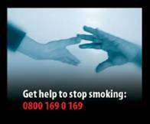
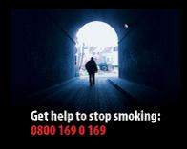
Pharmacotherapy
Pharmacotherapy + behavioural counselling improves long-term quit rates
Smokers of 10 or more cigarettes a day
who are ready to stop should be encouraged to use pharmacologial support as a cessation aid
Aveyard P, West R. Managing smoking cessation. BMJ 2007;335;37-41

Slide 38
Nicotine replacement
Begin NRT on the quit date, (apply patches the night before)
Use a dose that controls the withdrawal symptoms
NRT provides levels of nicotine well below smoking
Prescribe in blocks of two weeks
Arrange follow up to provide support
Use a full dose for 6 to 8 weeks then stop
or reduce the dose gradually over 4 weeks.
NRT increases the odds of quitting about 1.5 to 2 fold
Silagy C, et al. Nicotine replacement therapy for smoking cessation. Cochrane Database Systematic Reviews 2004

Slide 39
NRT: Nicotine levels in smokers
Venous levels after one cigarette
Arterial levels
after one cigarette
NRT increases the odds of quitting about 1.5 to 2 fold
Adapted from : Henningfield JE. Nicotine medications for smoking cessation. N Engl J Med 1995;333:1196-203

Slide 40
NRT: Nicotine patches
Patches provide a slow, consistent release of nicotine throughout the day
Available in various shapes and sizes,
Common side effects with patches include skin sensitivity and irritation
NRT increases the odds of quitting about 1.5 to 2 fold
Adapted from : Henningfield JE. Nicotine medications for smoking cessation. N Engl J Med 1995;333:1196-203

Slide 41
NRT: Nicotine nasal spray
Nasal sprays more closely mimic nicotine from cigarettes
Common side effects with nasal sprays include nasal and throat irritation, coughing and oral burning
NRT increases the odds of quitting about 1.5 to 2 fold
Adapted from : Henningfield JE. Nicotine medications for smoking cessation. N Engl J Med 1995;333:1196-203

Slide 42
NRT: Nicotine gum
Instruct the patient to ‘chew and park’
Absorption may be impaired by coffee and some acidic drinks
Common side effects with gum include gastrointestinal disturbances and jaw pain
Dentures may be a problem!
NRT increases the odds of quitting about 1.5 to 2 fold
Adapted from : Henningfield JE. Nicotine medications for smoking cessation. N Engl J Med 1995;333:1196-203

Slide 43
NRT: Nicotine lozenges
Nicotine tablets deliver 2-mg or 4-mg dosages of nicotine over 30-minutes
Common side effects with gum include burning sensations in the mouth, sore throat, coughing, dry lips, and mouth ulcers
NRT increases the odds of quitting about 1.5 to 2 fold
Adapted from : Henningfield JE. Nicotine medications for smoking cessation. N Engl J Med 1995;333:1196-203

Slide 44
Bupropion
Begin bupropion a week before the quit date
Normal dose 150mg bd, (reduce in elderly, liver/renal disease)
Contra-indicated in patients with epilepsy, anorexia nervosa, bulimia, bipolar disorder or severe liver disease.
The most common side effects are insomnia (up to 30%), dry mouth (10-15%), headache (10%), nausea (10%), constipation (10%), and agitation (5-10%)
Interaction with antidepressants, antipsychotics and anti-arrhythmics
Bupropion increases the odds of quitting about 2 fold
Hughes J, et al. Antidepressants for smoking cessation. Cochrane Database Systematic Reviews 2007

Slide 45
Nortryptiline
Tri-cyclic antidepressant
Not licensed for smoking cessation
Low cost
Side-effects include sedation, dry mouth, light-headedness, cardiac arrhythmia
Contra-indicated after recent myocardial infarction
Nortryptiline increases the odds of quitting about 2 fold
Hughes J, et al. Antidepressants for smoking cessation. Cochrane Database Systematic Reviews 2007

Slide 46
Varenicline
Begin varenicline a week before the quit date, increasing dose gradually.
Alleviates withdrawal symptoms, reduces urge to smoke
Common side effects include: nausea (30%), insomnia, (14%), abnormal dreams (13%), headache (13%), constipation (9%), gas (6%) and vomiting (5%).
Contra-indicated in pregnancy
New drug
Varenicline increases the odds of quitting about 2.5 fold
Cahill K, et al. Nicotine receptor partial agonists for smoking cessation. Cochrane Database Syst Rev 2007

Slide 47
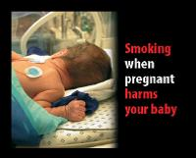
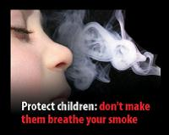
Pregnancy
Smoking has adverse effects on unborn child
20-30% of smoking women quit in pregnancy
Smoking cessation programmes are effective
NRT is assumed to be safe
Bupropion and varenicline are contra-indicated
Post-partum follow up reduces the 70% relapse rate
Pregnancy is often a trigger for quitting
Lumley J, et al. Interventions for promoting smoking cessation during pregnancy. Cochrane Database Systematic Reviews 2000

Slide 48
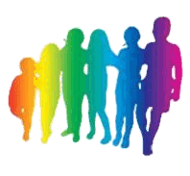
Adolescents
50%
of young people who continue to smoke will die from smoking
World Health Organization. The Tobacco Atlas. http://www.who.int/tobacco/statistics/tobacco_atlas/en
Every day, up to 100,000 young people globally become addicted to tobacco
Tobacco fact sheet. August 2000 http://tobaccofreekids.org/campaign/global/docs/facts.pdf

Slide 49

Adolescents
Parental / other family members smoking
Less ‘connectedness’ to family, school and society
Ready availability of cigarettes
Peer pressure
Advertising, influence of media
Concern over weight
Risk
Every day, up to 100,000 young people globally become addicted to tobacco
Midford R, et al. Principles that underpin effective school-based drug education. J Drug Educ 2002;32:363-86

Slide 50
Adolescents
School-based policies around smoking education
Good social support
Higher levels of physical activity
Risk
Every day, up to 100,000 young people globally become addicted to tobacco
Midford R, et al. Principles that underpin effective school-based drug education. J Drug Educ 2002;32:363-86

Slide 51
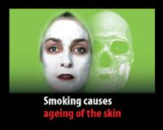
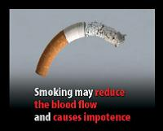
Adolescents
Address the issues that matter to the teenager
Brief interventions are likely to be effective
Pharmacotherapies are not licensed in teenagers
Teenagers care about the immediate benefits
to their appearance, well being and financial status
rather more than future health gains
Grimshaw GM, et al. Tobacco cessation interventions for young people. Cochrane Database Systematic Reviews. 2006

Slide 52
Mental health
Psychotic disorders are associated with three times the risk being a heavy smokers (35% vs 9%)
Smoking may alleviate symptoms of psychosis
Smoking and depression are related
The antidepressants, bupropion and nortriptyline are effective in assisting smoking cessation
Bupropion interacts with other antidepressants
People with mental health problems are more likely to smoke than those without mental illness
McNeil A. Smoking and mental health - a review of the literature Smoke Free London Programme: London, 2001

